Slide 1
JFK TAXI-OUT Linear Regression
Nov 2019 – Jan 2020
Deirdre Boland
07 Feb 2025

Slide 2
Objective and dataset
Objective
Create Linear Regression Model of JFK Taxi-Out, using data scraped from an Academic Paper under Review by IEEE transportation covering Nov 2019- Jan 2020 (D Kansal, Kaggle dataset)
Value
At JFK airport Taxi-Out prediction is an important concept for calculating runway time and directly impacts the cost of flights.
Dataset
5 text based features/variables
Airline and flight number indicators (TAIL_NUM, OP_UNIQUE_CARRIER)
Destination (DEST) covered by numeric features of distance and scheduled flight time
Wind direction (Wind e.g. NW, E etc) – have wind speed and gust in numeric
Climate/weather (Condition) – converted to numeric by using frequency counts (more severe weather less frequent)
18 numeric features, including target feature(TAXI_OUT)
Covering weather/conditions at flight time and flight details e.g. Time, duration
Scheduled Arrival Time (CRS_ARR_M) excluded – arrival at another airport, includes time difference offsets. This feature is covered by scheduled duration of flight feature
Final 18 numeric features (17 original & 1 generated from Condition text feature)
Reference – Kaggle page Flight Take Off Data - JFK Airport

Slide 3
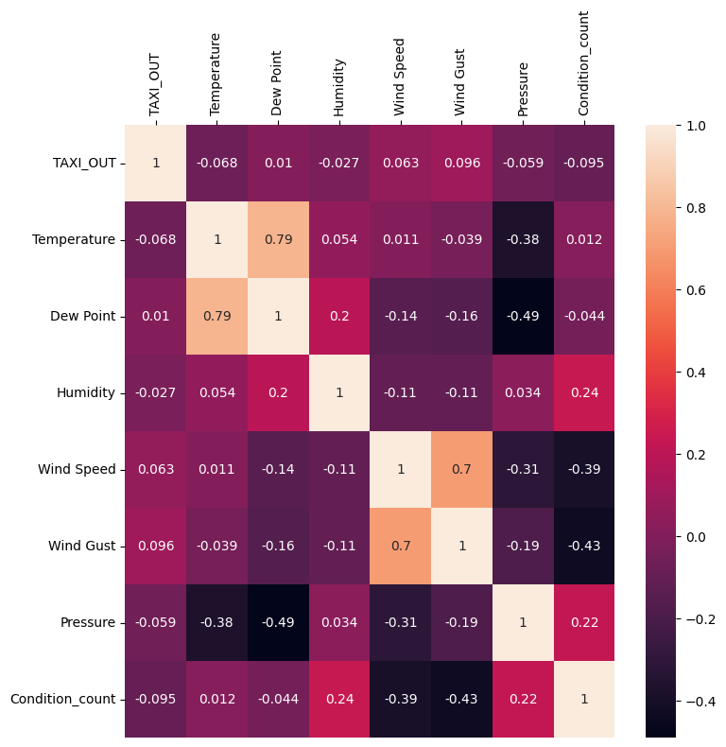
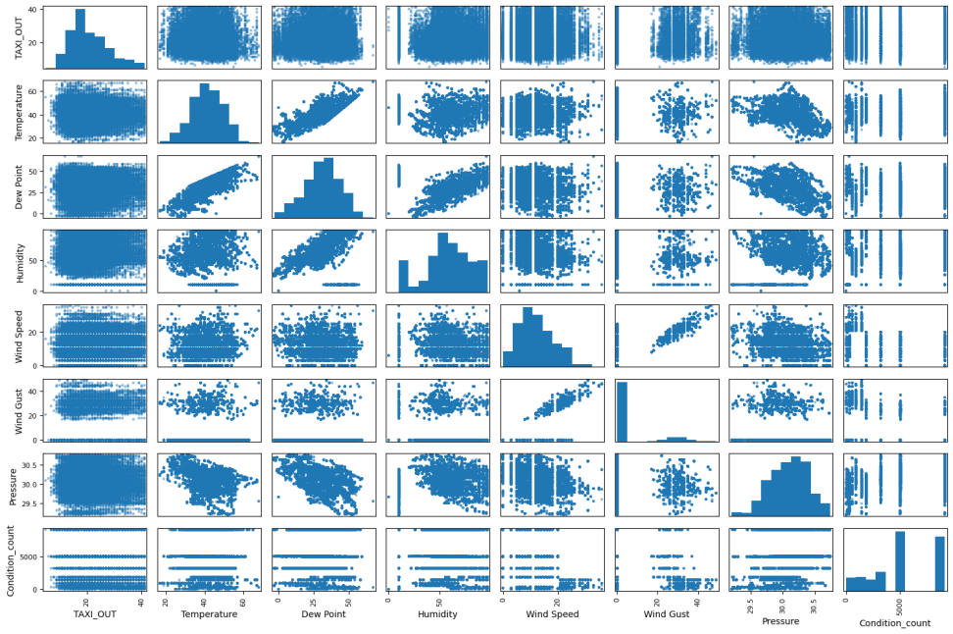
Correlation Matrix – Weather/Climate
Correlation Matrix
Scatter Matrix

Slide 4
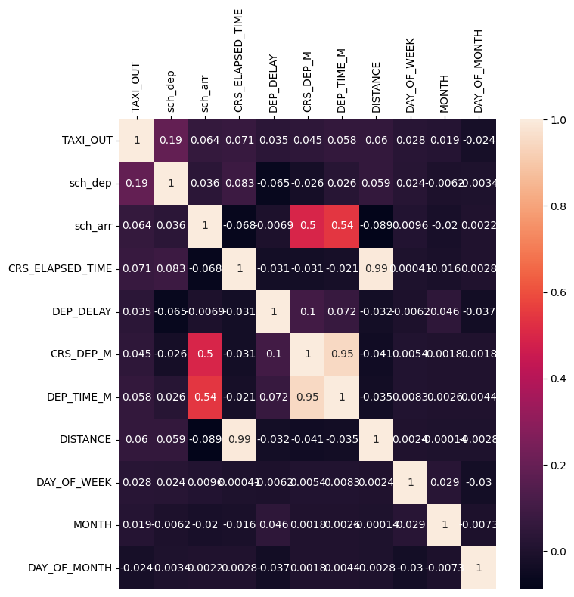
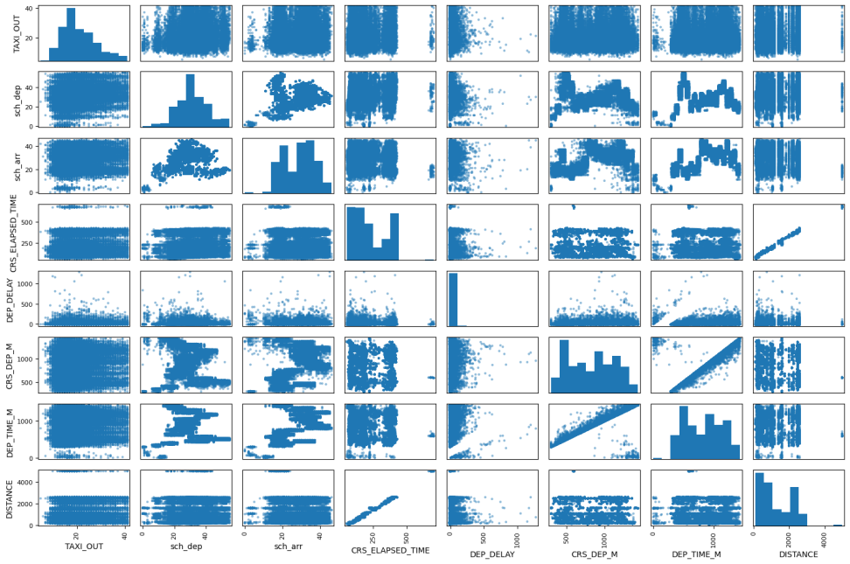
Correlation Matrix – Flight Details
Correlation Matrix
Scatter Matrix
Number of flights scheduled for arrival./departure (sch_arr, sch_dep)
Departure delay of the flight (DEP_DELAY) - is calculation of *Actual Departure Time (DEP_TIME_M ) subtract Scheduled Departure Time (CRS_DEP_M) * Gate checkout of the flight not the take off time
Scheduled journey time of the flight (CRS_ELAPSED_TIME)

Slide 5
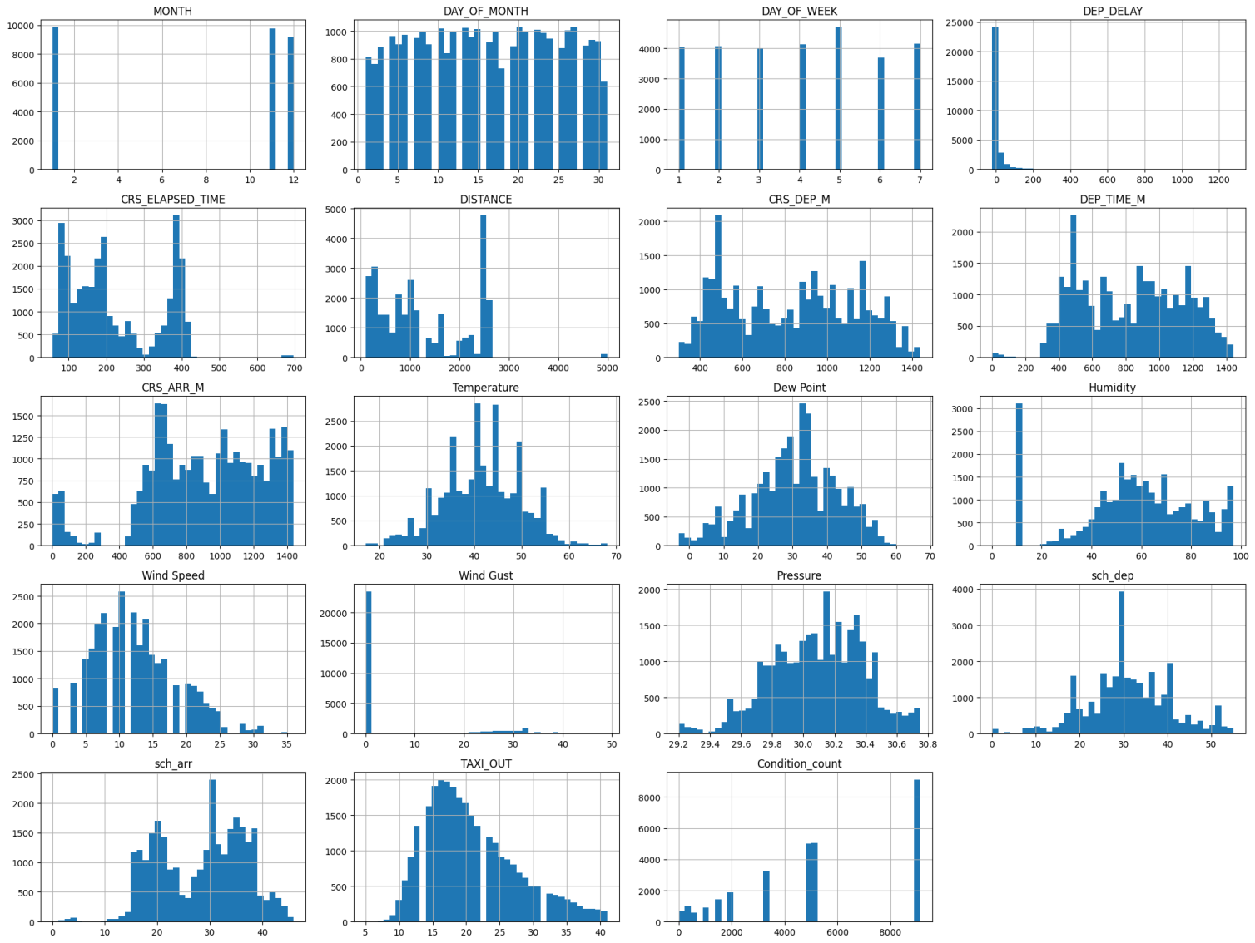
Linear regression Model
All models scaled using standard scaler. 80% train, 20% test
R² 0-1, higher is better fit
3 features (highest corrl, green)
Multi Linear Regression (MLR) or Ordinary Least Squares (OLS) – r² 0.059
Lasso – r² 0.057
Ridge – r² 0.059
8 features (>0.5 corrl, ambr non-dash & green)
MLR/OLS – r² 0.077
Lasso – r² 0.074
Ridge – r² 0.077
14 features (all except red)
MLR/OLS – r² 0.083
Lasso – r² 0.080
Ridge – r² 0.083
Alpha tuning (set at 0.1 above)
Regularisation penalty in ridge and lasso modelling.
Increasing value on Lasso made model dramatically worse but minimal impact Ridge
Expected as increasing alpha will get rid of features on Lasso
Feature Histograms
(x- axis, horiz = units bin 40, y- axis, vert = frequency)
variable

Slide 6
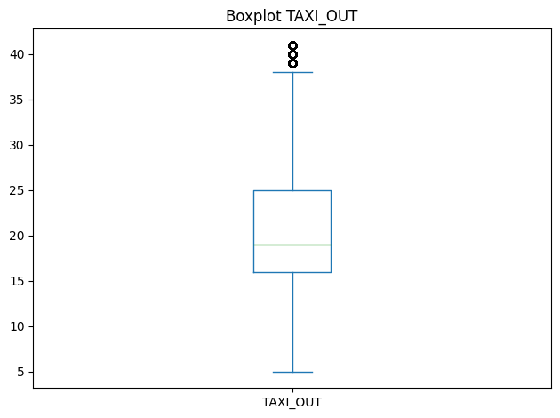
Conclusion and next steps
Linear regression model not viable to model JFK Taxi-out with this data set
low correlation of features leading to underfitting (erroneous outcomes on new data)
Limited dataset Nov 2019 – Jan 2020, includes holidays and wintry conditions
Majority Taxi-out time under 25 mins with a min of 5 and max of 40mins
Need more information on Taxi-out metric and calculation
What is target? Is consistent 5-15 min realistic?
What other data not collected, might be impacting? E.g. impact of different terminals (5) and runways (4), staffing levels

Slide 7
Q&A

